Slide 1

Healthy Water
Level: Grade 3-6

Slide 2
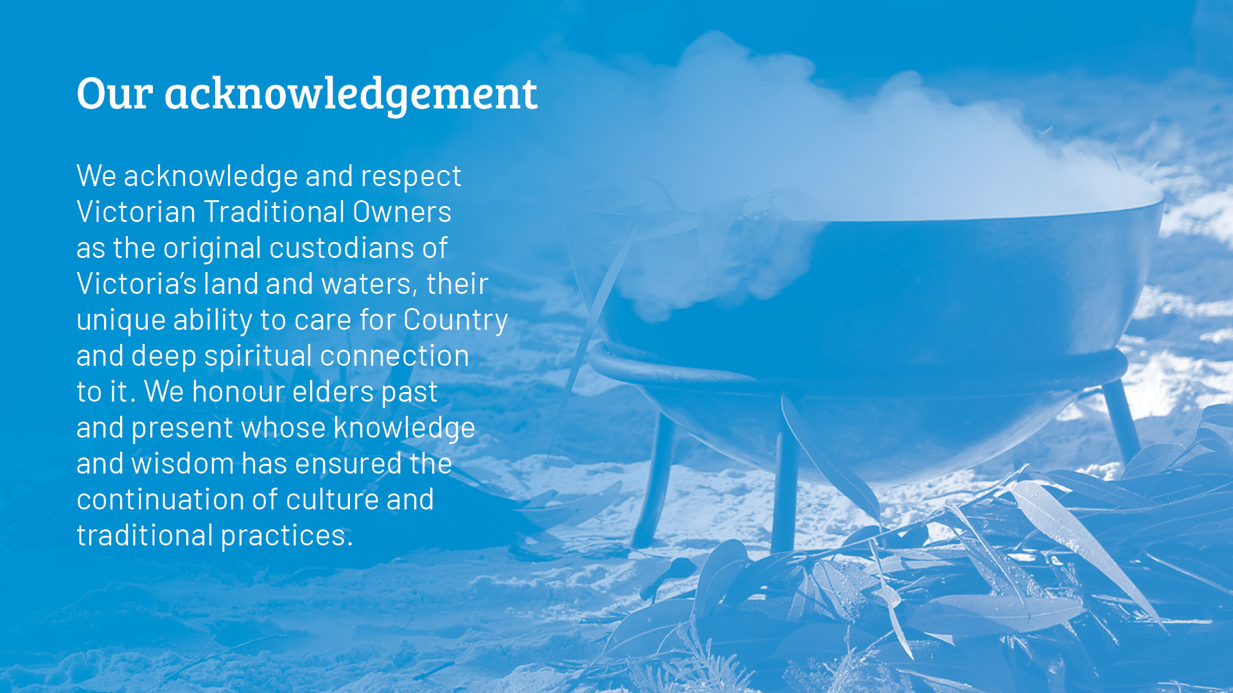

Slide 3

We’ll answer these questions:
  Why does your body need water?
  What happens when your body doesn’t get enough water?
  Why should we avoid sugary drinks?

Slide 4

Minds on!
Think about how much water you drink each day.
Do you think you drink enough?

Slide 5

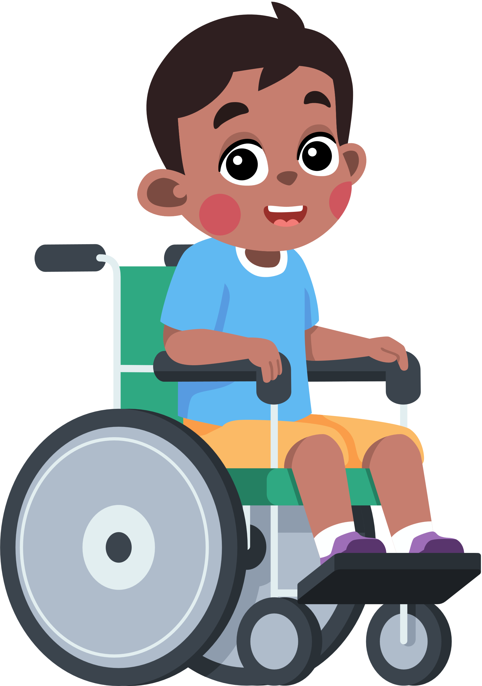
I think...
I don’t
drink enough water
I’m not sure!
I drink enough water

Slide 6



Fact sort
To help us think about the benefits
of water, we are going to explore
some facts.
Some are true and some are false.
Can you sort true from false?

Slide 7

Sort fact from fiction!
A. Water is the best fluid to drink for good health
B. The colour of your wee can show you if you
have drunk enough water
C. Your body is 10% water!
D. You can drink the tap water in most countries
around the world
E. You can actually get all the water you need from food
F. In Australia, tap water is the best choice
to stay hydrated
G. Our brains don’t work properly when we
get dehydrated
H. Water helps us sweat, which cools us down
I. You can last 10 days without water
J. Tap water is great, but Coca Cola is cheaper per litre.

Slide 8
True
False
A. Water is the best fluid to drink for good health
C. Your body is 10% water!
No - it is actually closer to 60%
B. The colour of your wee can show you if you
have drunk enough water
D. You can drink the tap water in most countries around the world. No. We are lucky. Only 50 out of the 195 countries have
drinkable tap water.
F. In Australia, tap water is the best choice to stay hydrated
E. You can actually get all the water you need from food. No. The best you can do is perhaps 50%, even eating foods with high water content.
G. Our brains don’t work properly when we get dehydrated
I. You can last 10 days without water. Nope. You’d only last 3-5 days.
H. Water helps us sweat, which cools us down
J. Tap water is great, but Coca Cola is cheaper per litre. No way! Tap water is $2.47 for 1,000 litres. 1,000 Litres
of Coca Cola would cost $2,840!

Slide 9

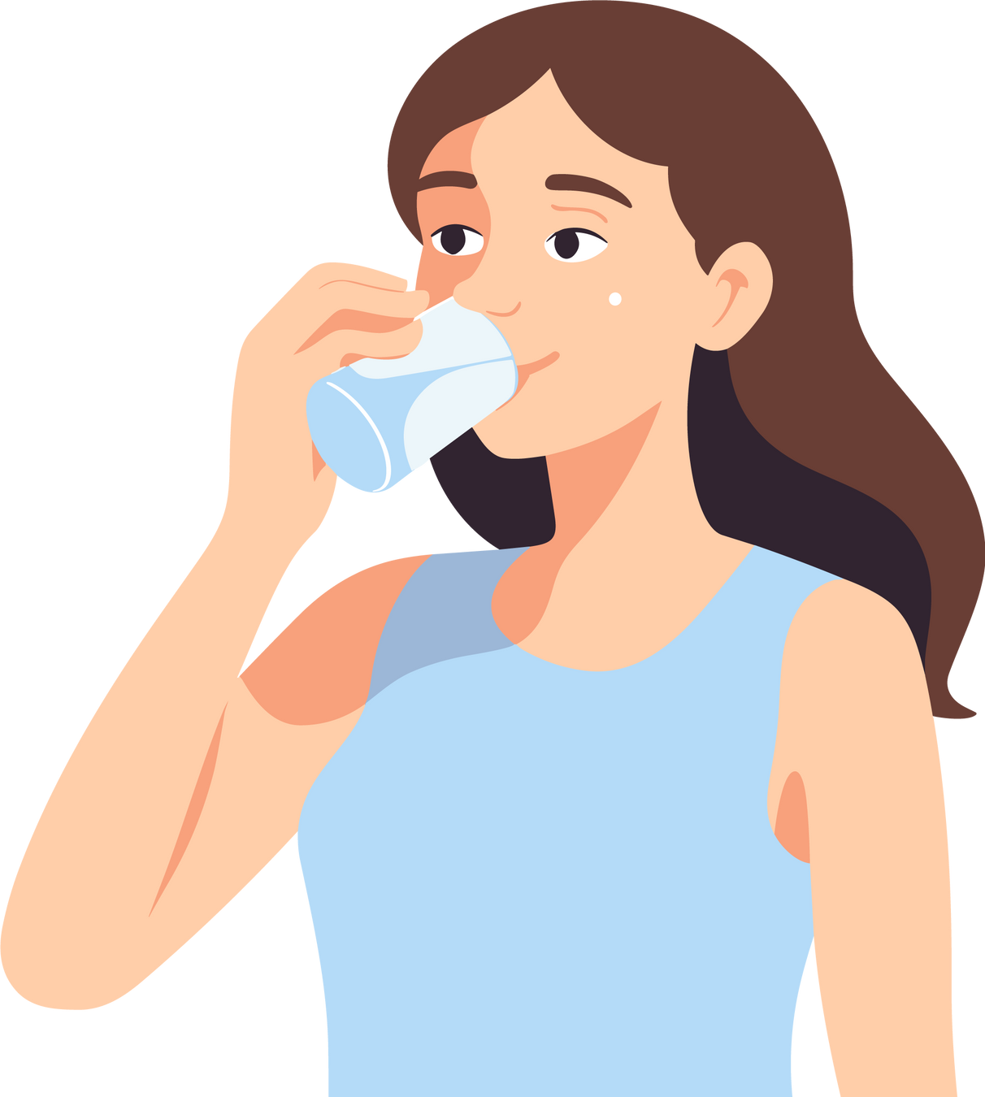

Why does your body need water?
Your body needs water to survive and work properly
Water is essential for digestion of food.
Water helps move nutrients around our bodies.
Water lets us control our body temperature.

Slide 10
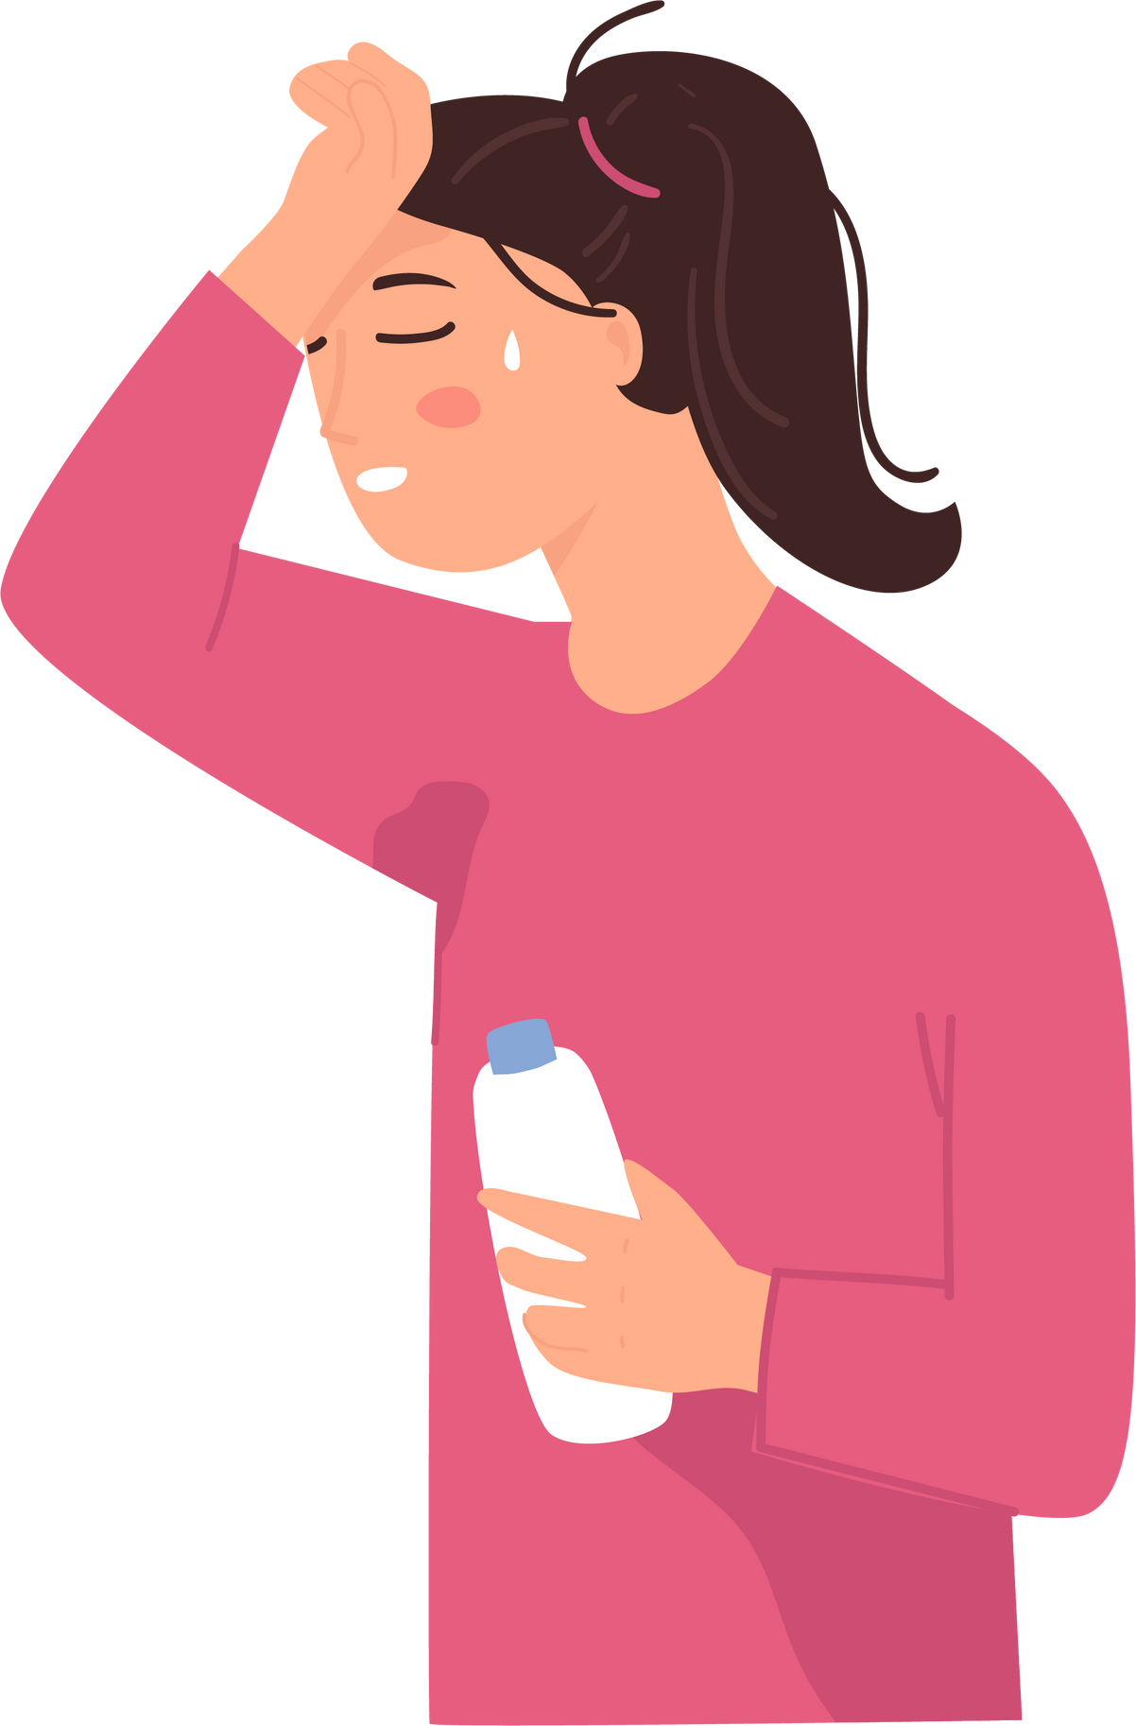

Mind map!
How do you know that you need to drink water?

Slide 11

Dehydration
Dehydration occurs when the body loses more fluids than it takes in...
Dehydration causes:
  Tiredness.
  Dizziness.
  Foggy brain; can’t concentrate.
  A range of other impacts.

Slide 12
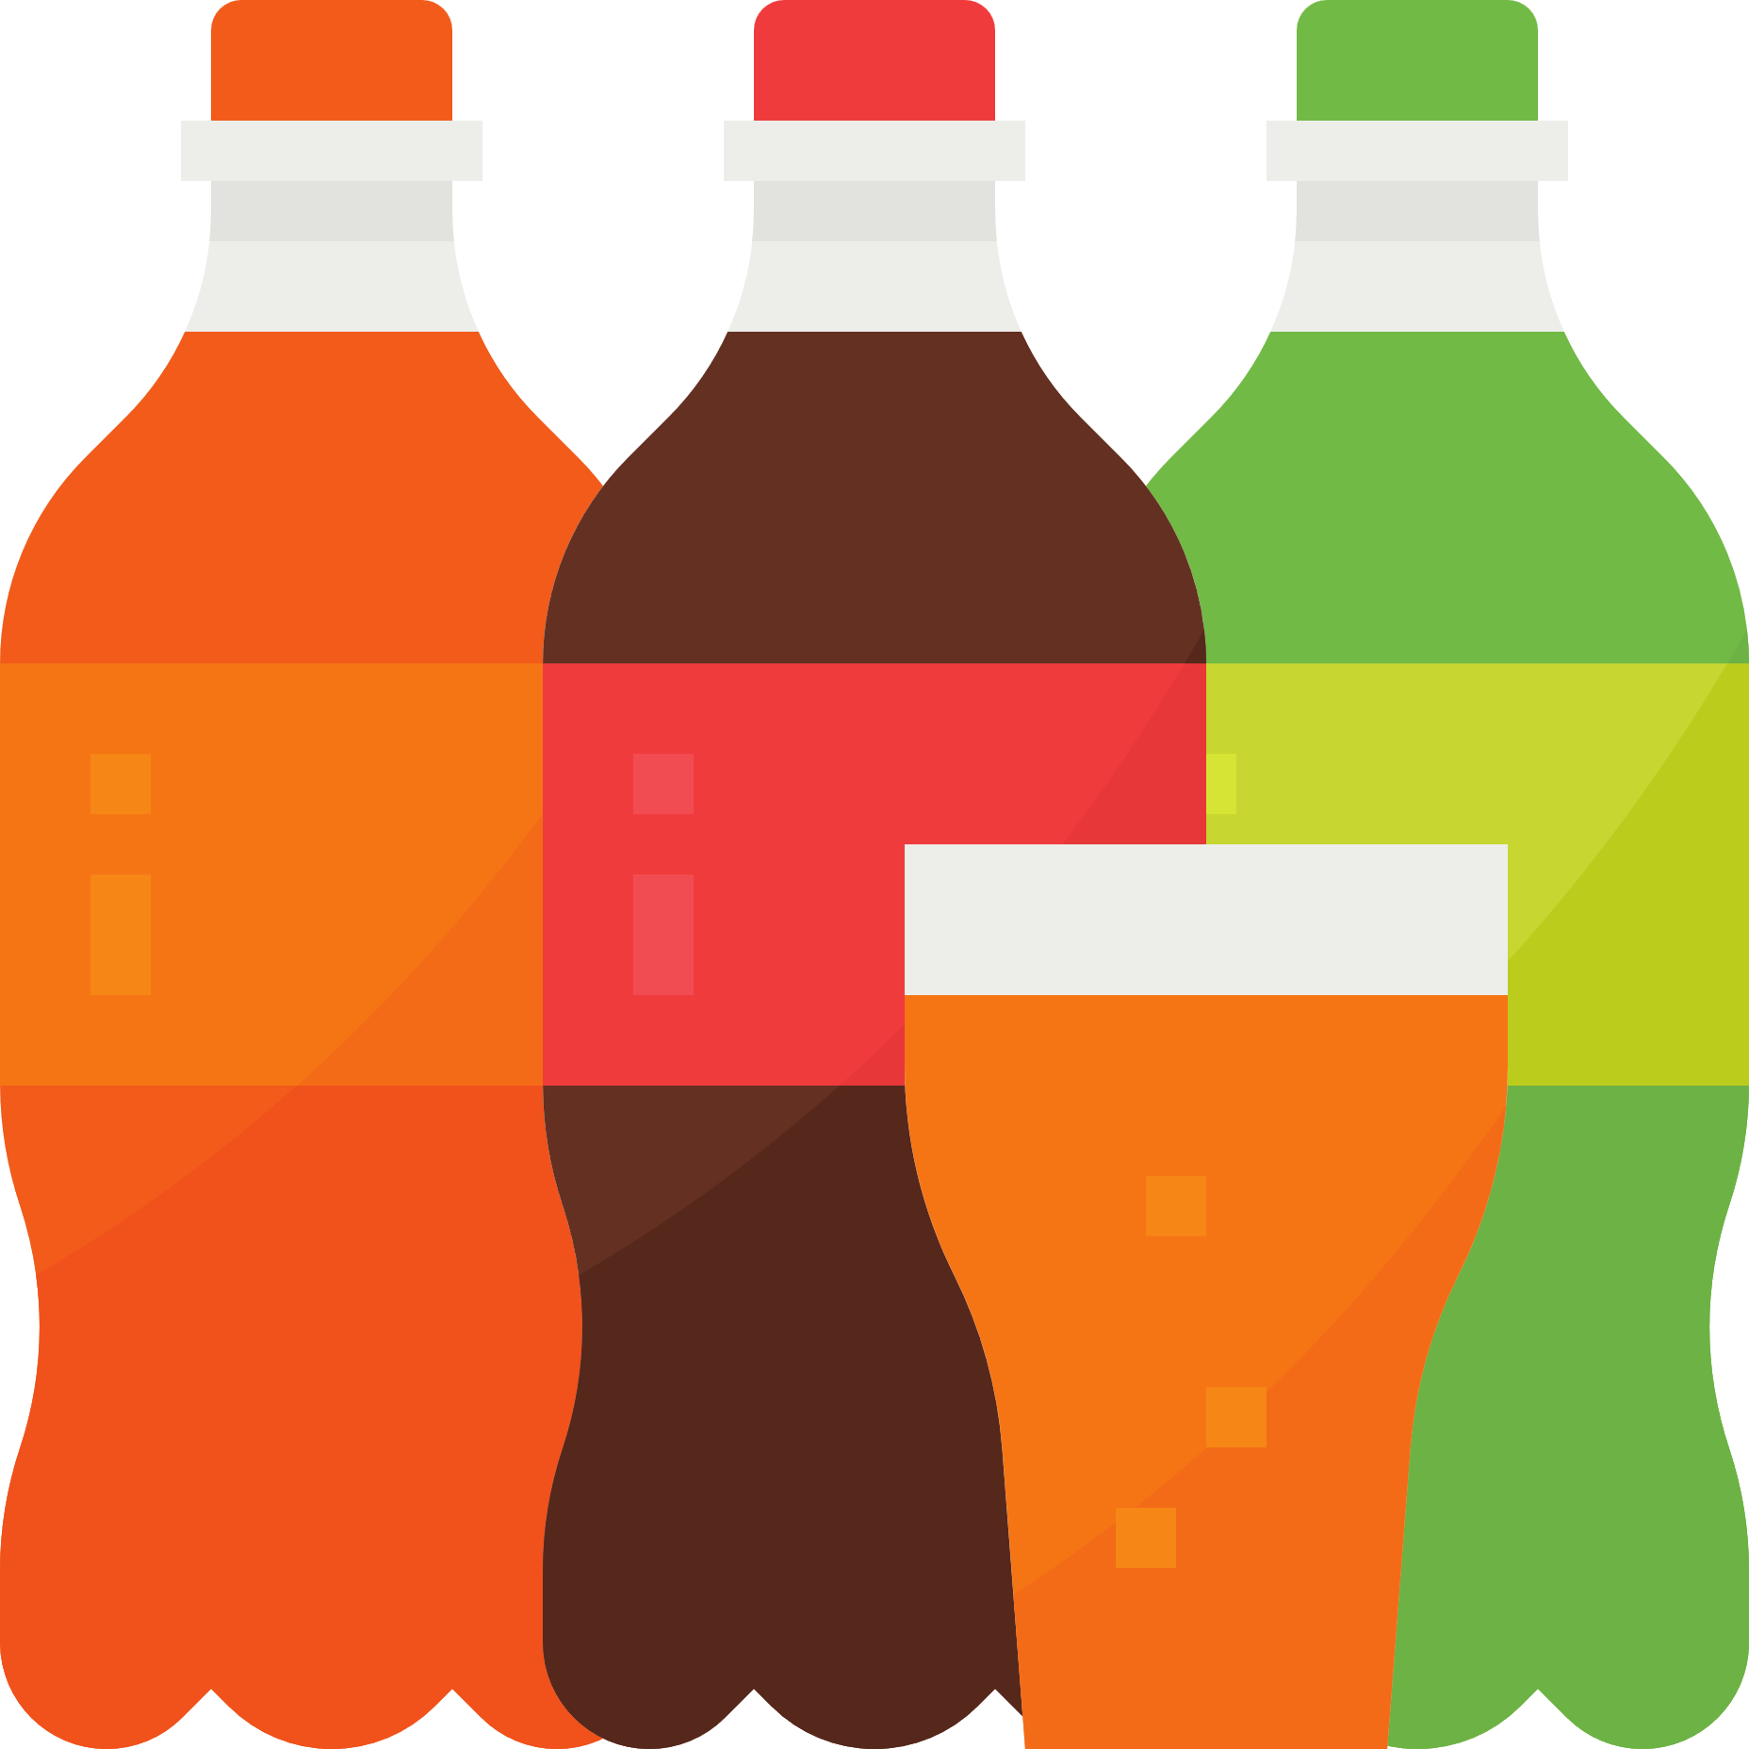

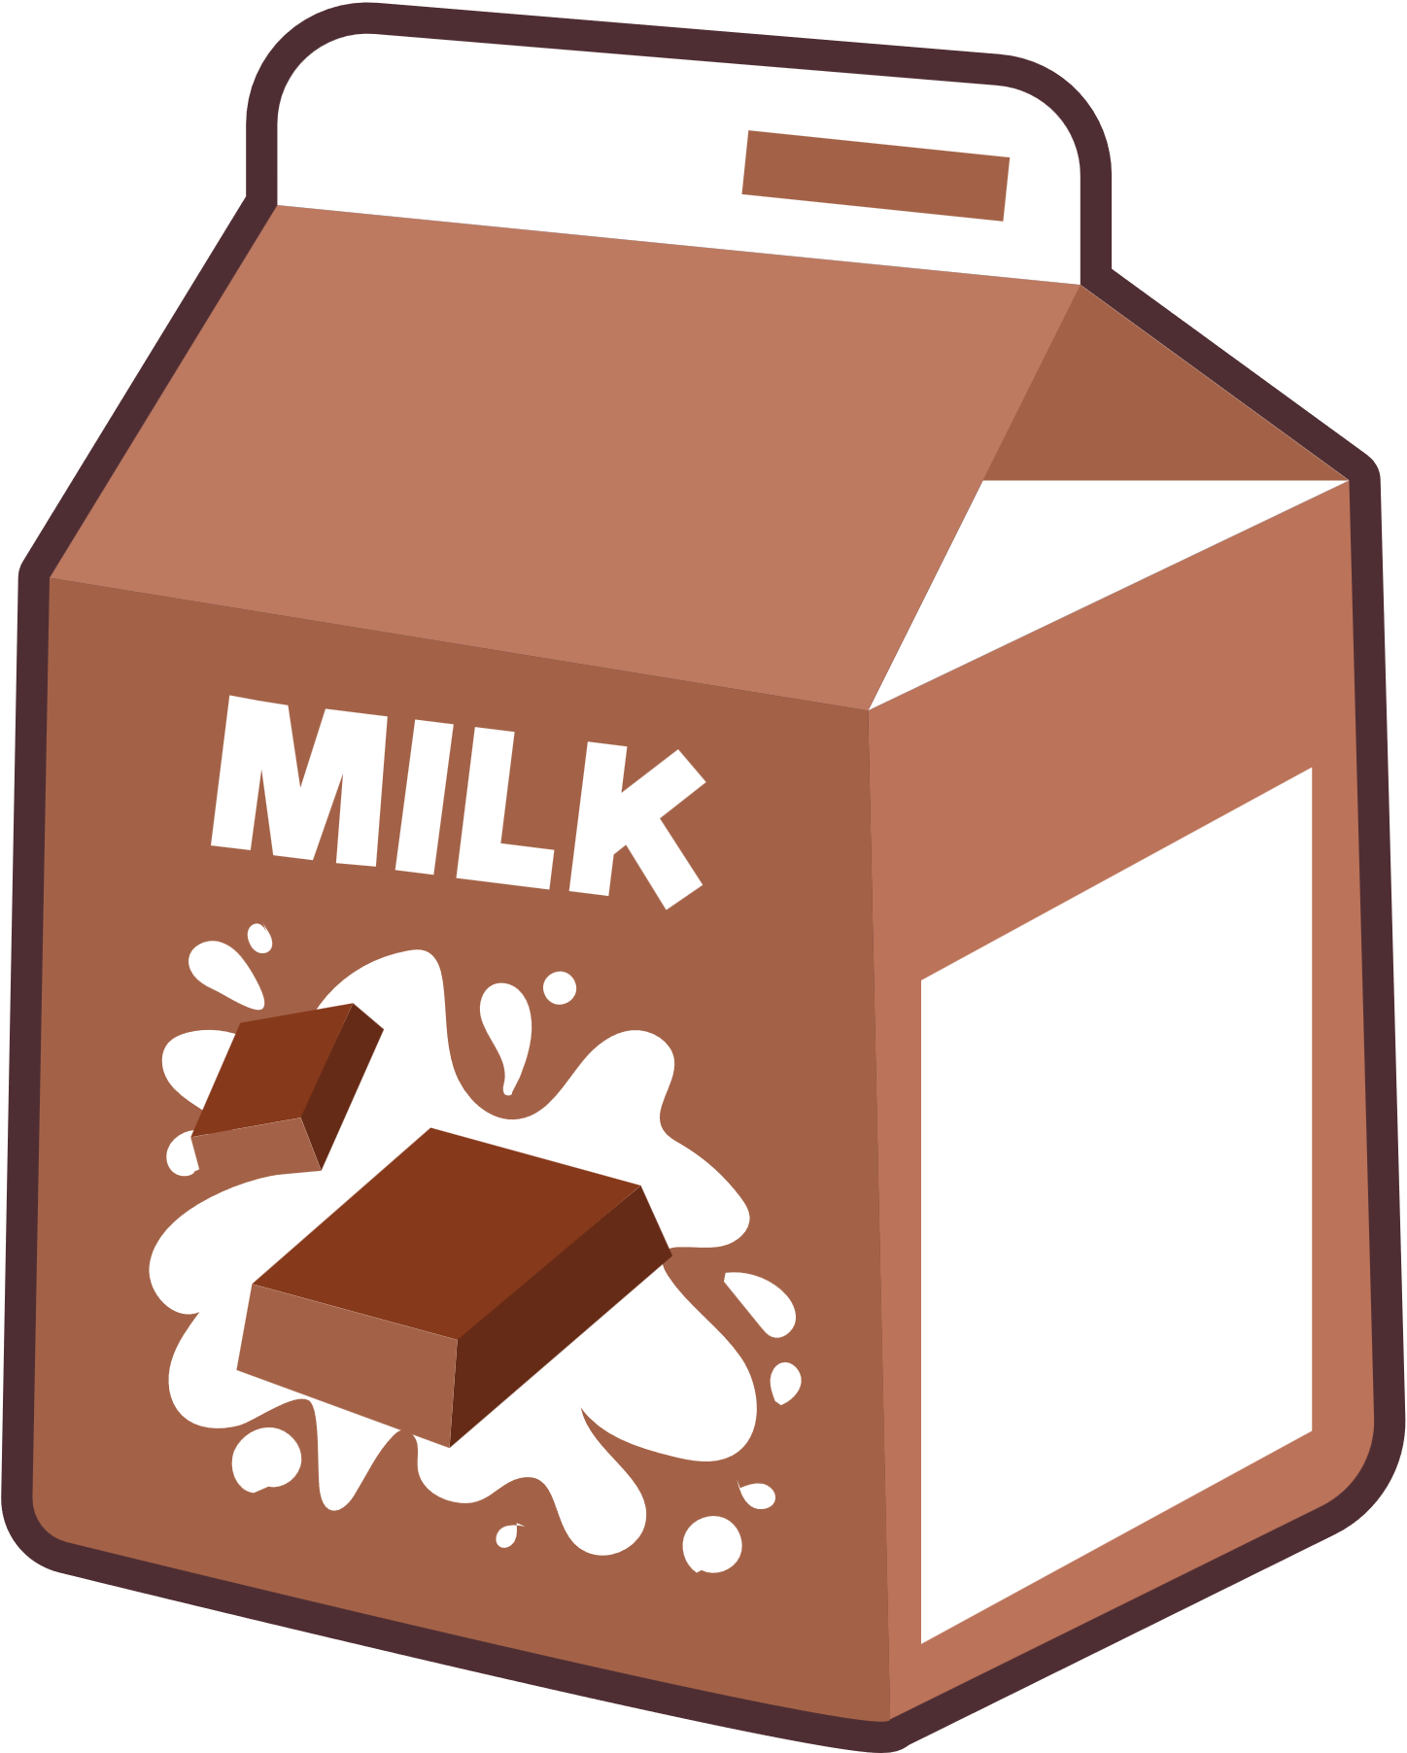
Sugary drinks
  We’ve learnt about what happens when we get dehydrated, and that tap water keeps us healthy and hydrated.
  But why don't we just drink things like energy drinks and chocolate milk?

Slide 13

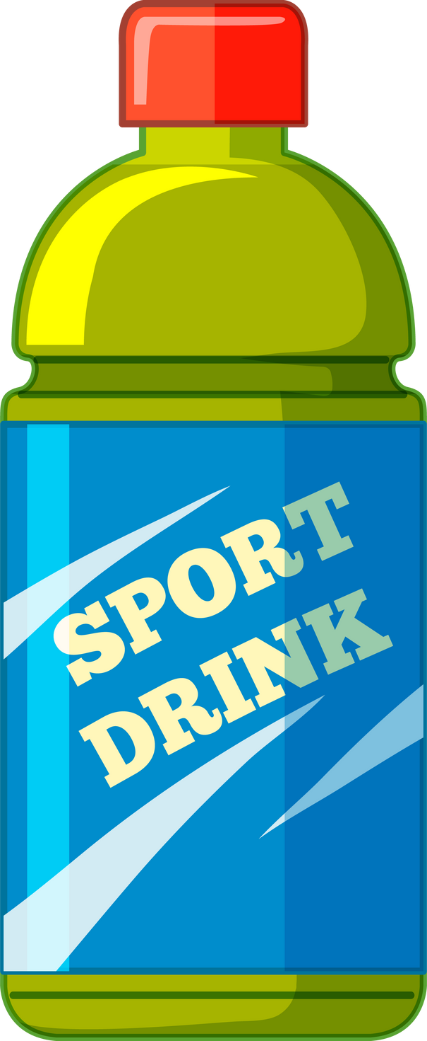
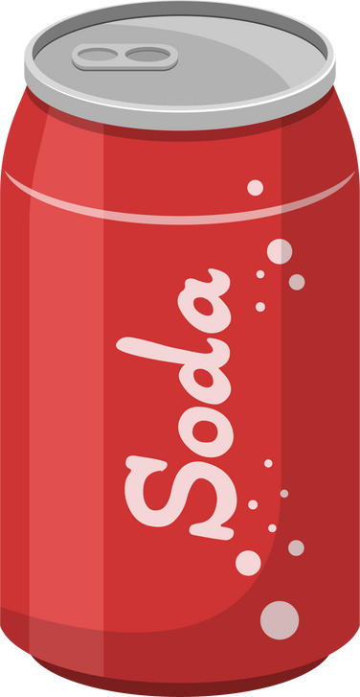
Sugary drinks are...
Why don't we just drink things like energy drinks and chocolate milk?
Because they are full of sugar!
...full of empty calories. This means energy without nutrients.
...bad for your teeth!
...setting you up for an energy CRASH.
...terrible for your heart, make you gain unhealthy weight, and are linked to lots of terrible diseases.

Slide 14
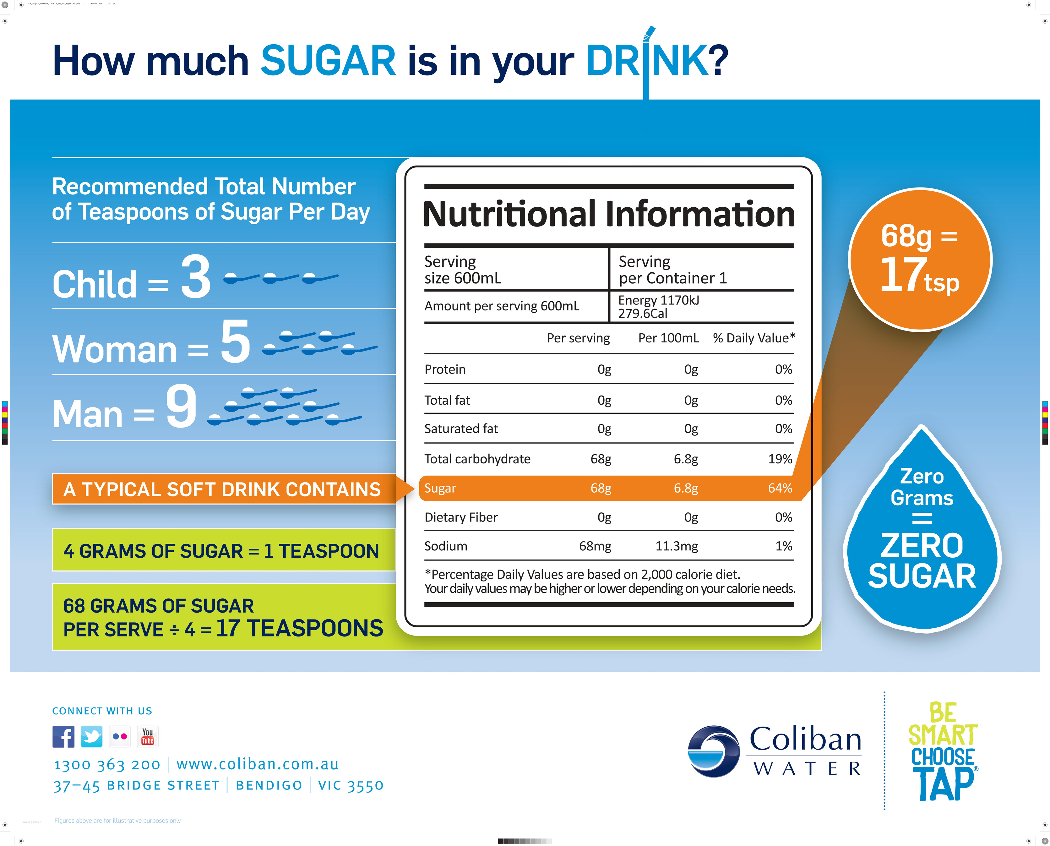

Slide 15
Activity: how much sugar?
For each example:
  Find the nutrition information label.
  Identify how much sugar there is in the drink.
  Does the drink have more or less than the recommended daily intake?
Remember: for children this is
12 grams!

Slide 16
Healthy water
  Our bodies need water to survive and work properly.
  Dehydration isn’t fun!
  Sugary drinks should be avoided as they are not good for you.
...now for your challenge!

Slide 17

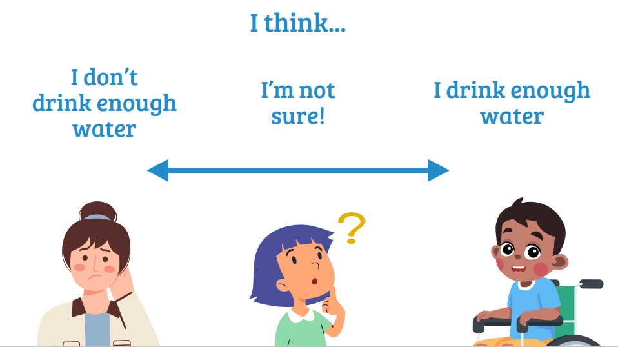
What do you think now?
Now that you’ve learnt more, do you want to change your position?

Slide 18
I think...
I don’t
drink enough water
I’m not sure!
I drink enough water

Slide 19
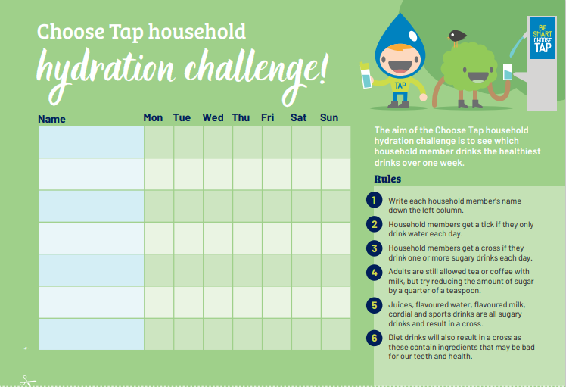

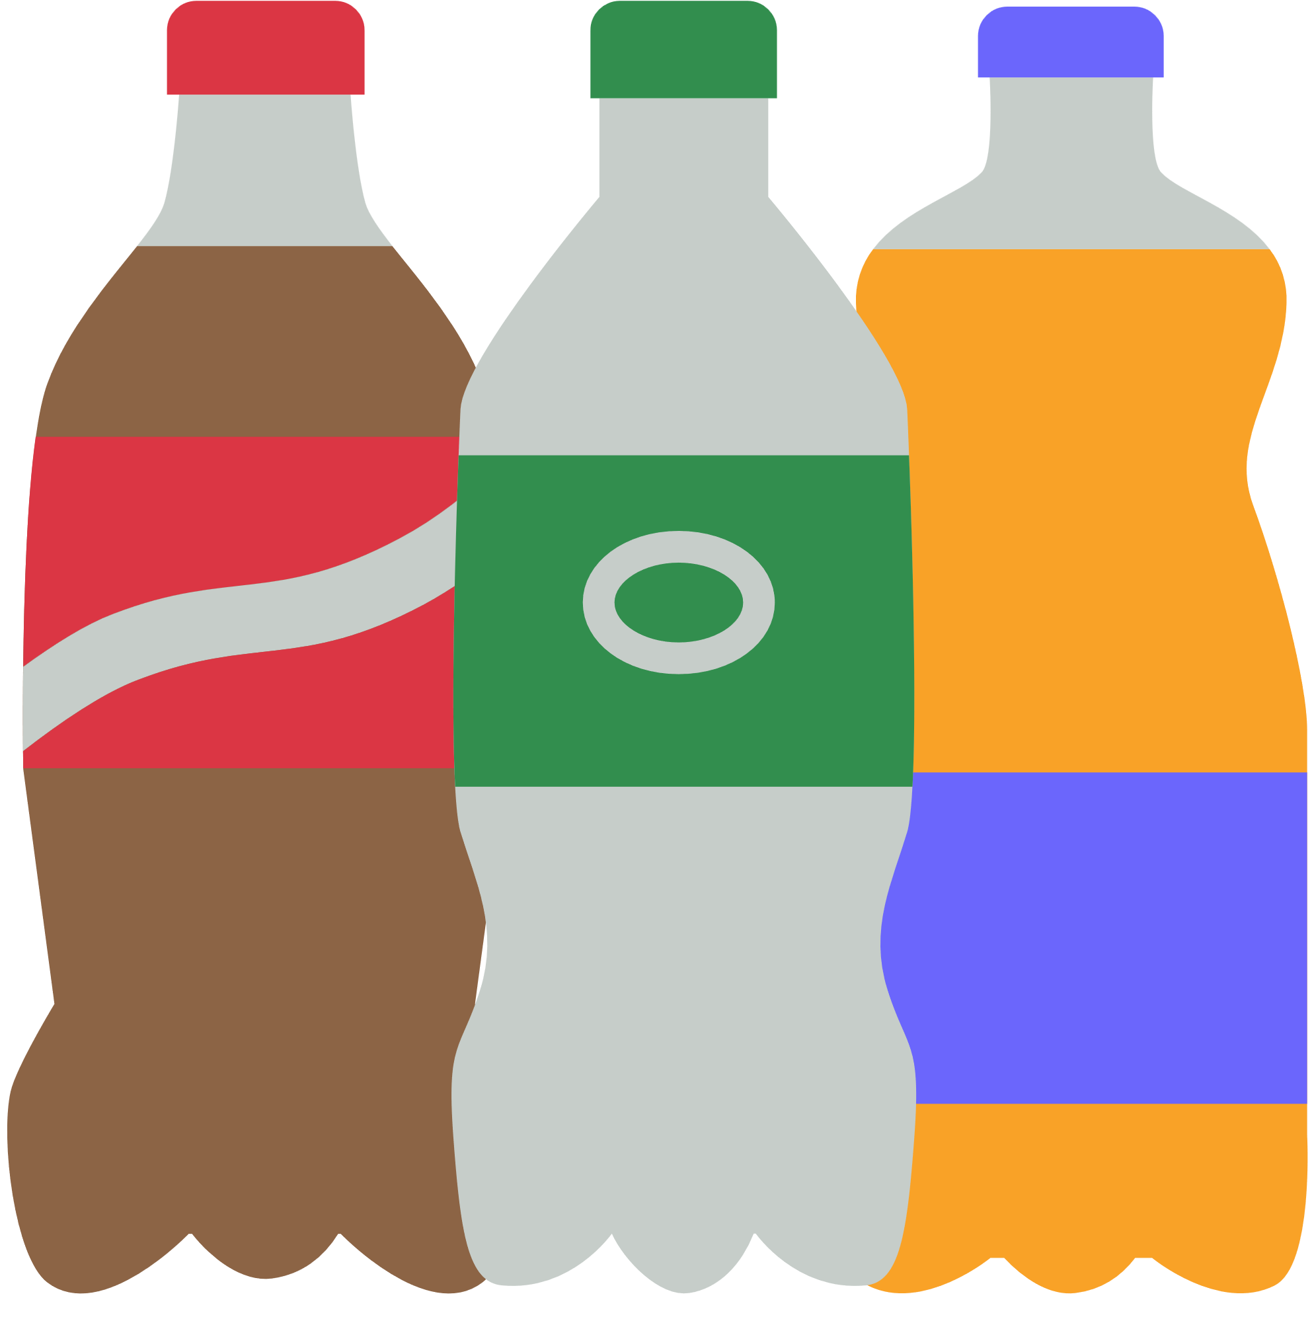
Take action!
Help your family stay hydrated.

Slide 20
Quiz
Let’s test your knowledge
1.What is the word for losing too much water
from your body?
A) Hydration
B) Overhydration
C) Dehydration
D) Rehydration
4. How many countries in the world can drink
their tap water?
A) 5
B) 50
C) 80
D) 195
2.Which of the following is a symptom of dehydration?
A) Increased energy
B) Dark yellow wee (urine)
C) Being cross
D) Cold hands
5. Why is too much sugar bad for you?
A) Empty calories
B) Damages your teeth
C) Bad for your heart
D) All the above
3.Which of the following drinks would we say
is a sugary drink?
A) Water
B) Unsweetened herbal tea
C) Milk
D) Regular cola
6. Why is water important to your body?
A) Digestion of food
B) Regulating temperature
C) Moving nutrients
D) All the above

